Slide 1

Heart Disease: A Machine Learning Approach
Amanda, Charity, Sergio

Slide 2

Predicting Heart Disease
Our goal is to utilize machine learning models on a dataset of patient information to predict whether a person has heart disease.

Slide 3
Agenda
Introduction
Extracting Data
Transforming/
Cleaning Data
Logistic Regression model
Using KerasTuner
Primary goals

Slide 4
Extracting Data
4 Databases
Cleveland, Hungary , Switzerland, Va Long Beach
Cleveland Data extracted from Repo
Remaining from .DATA file
Combined All into 1 CSV file

Slide 5
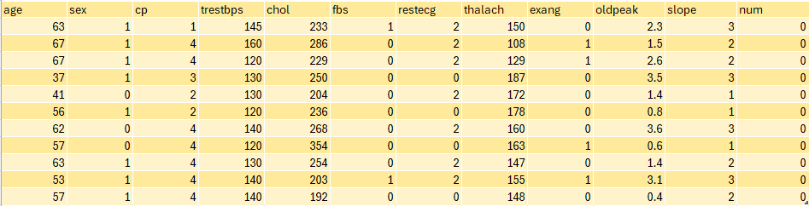
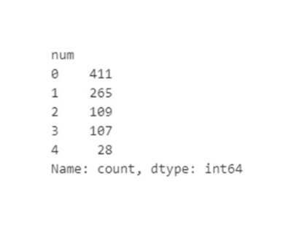
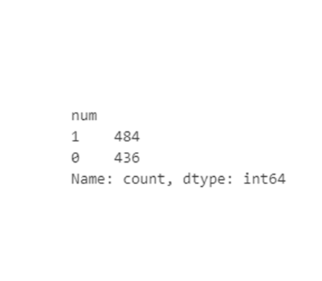
Contains 920 Rows & 14 Columns
All appear to be multivariate type of datasets
Original
Binary

Slide 6
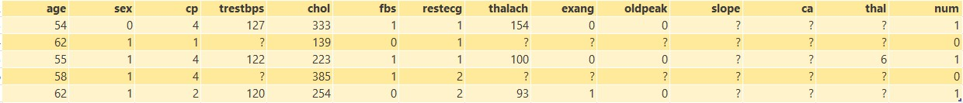
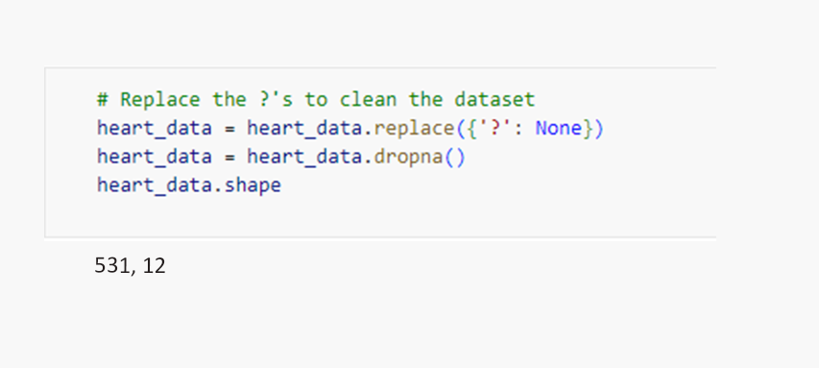
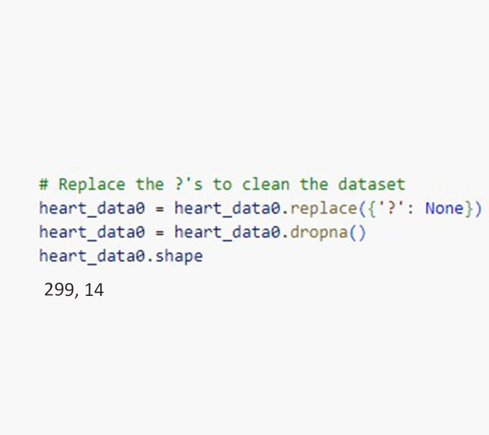
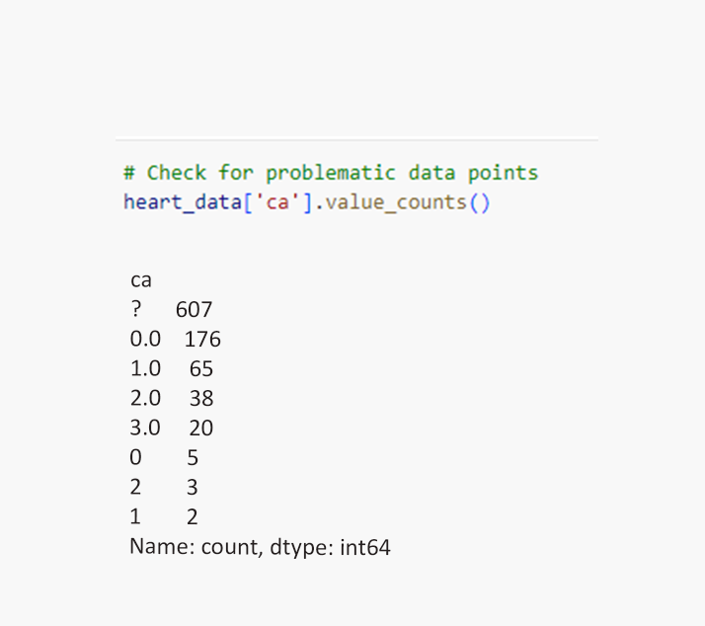
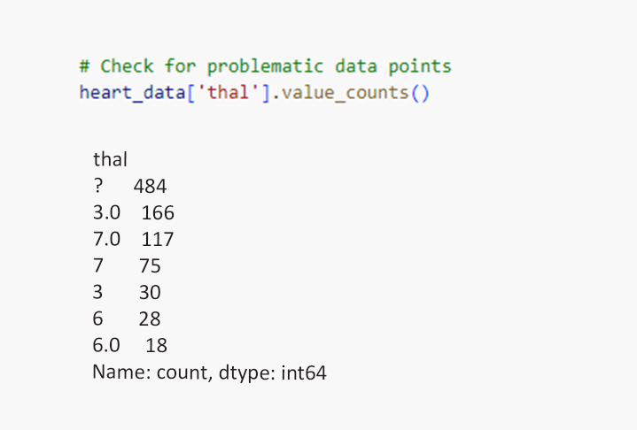
Transforming/Cleaning Data

Slide 7
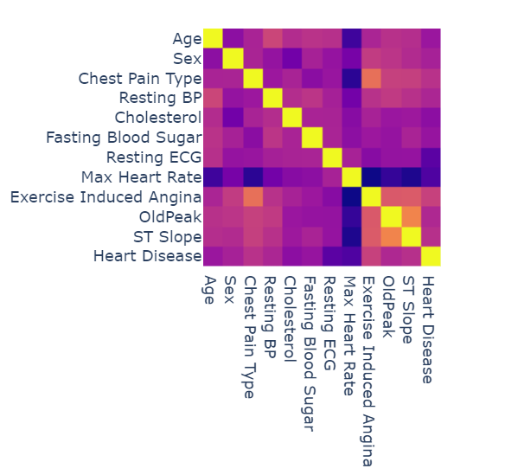
Heart Disease Prediction Correlation

Slide 8
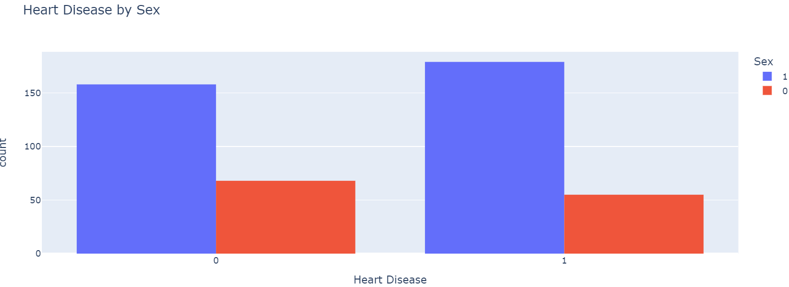
Histogram Bar Chart

Slide 9
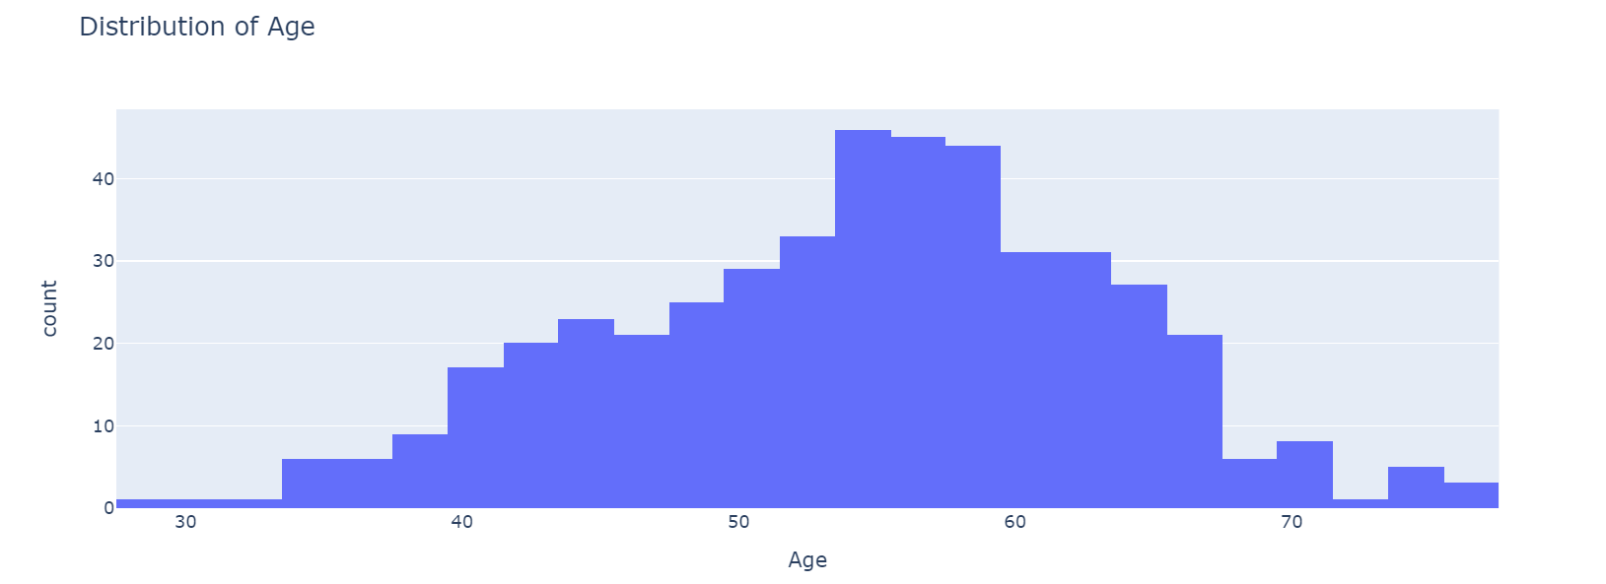
Histogram Distribution

Slide 10
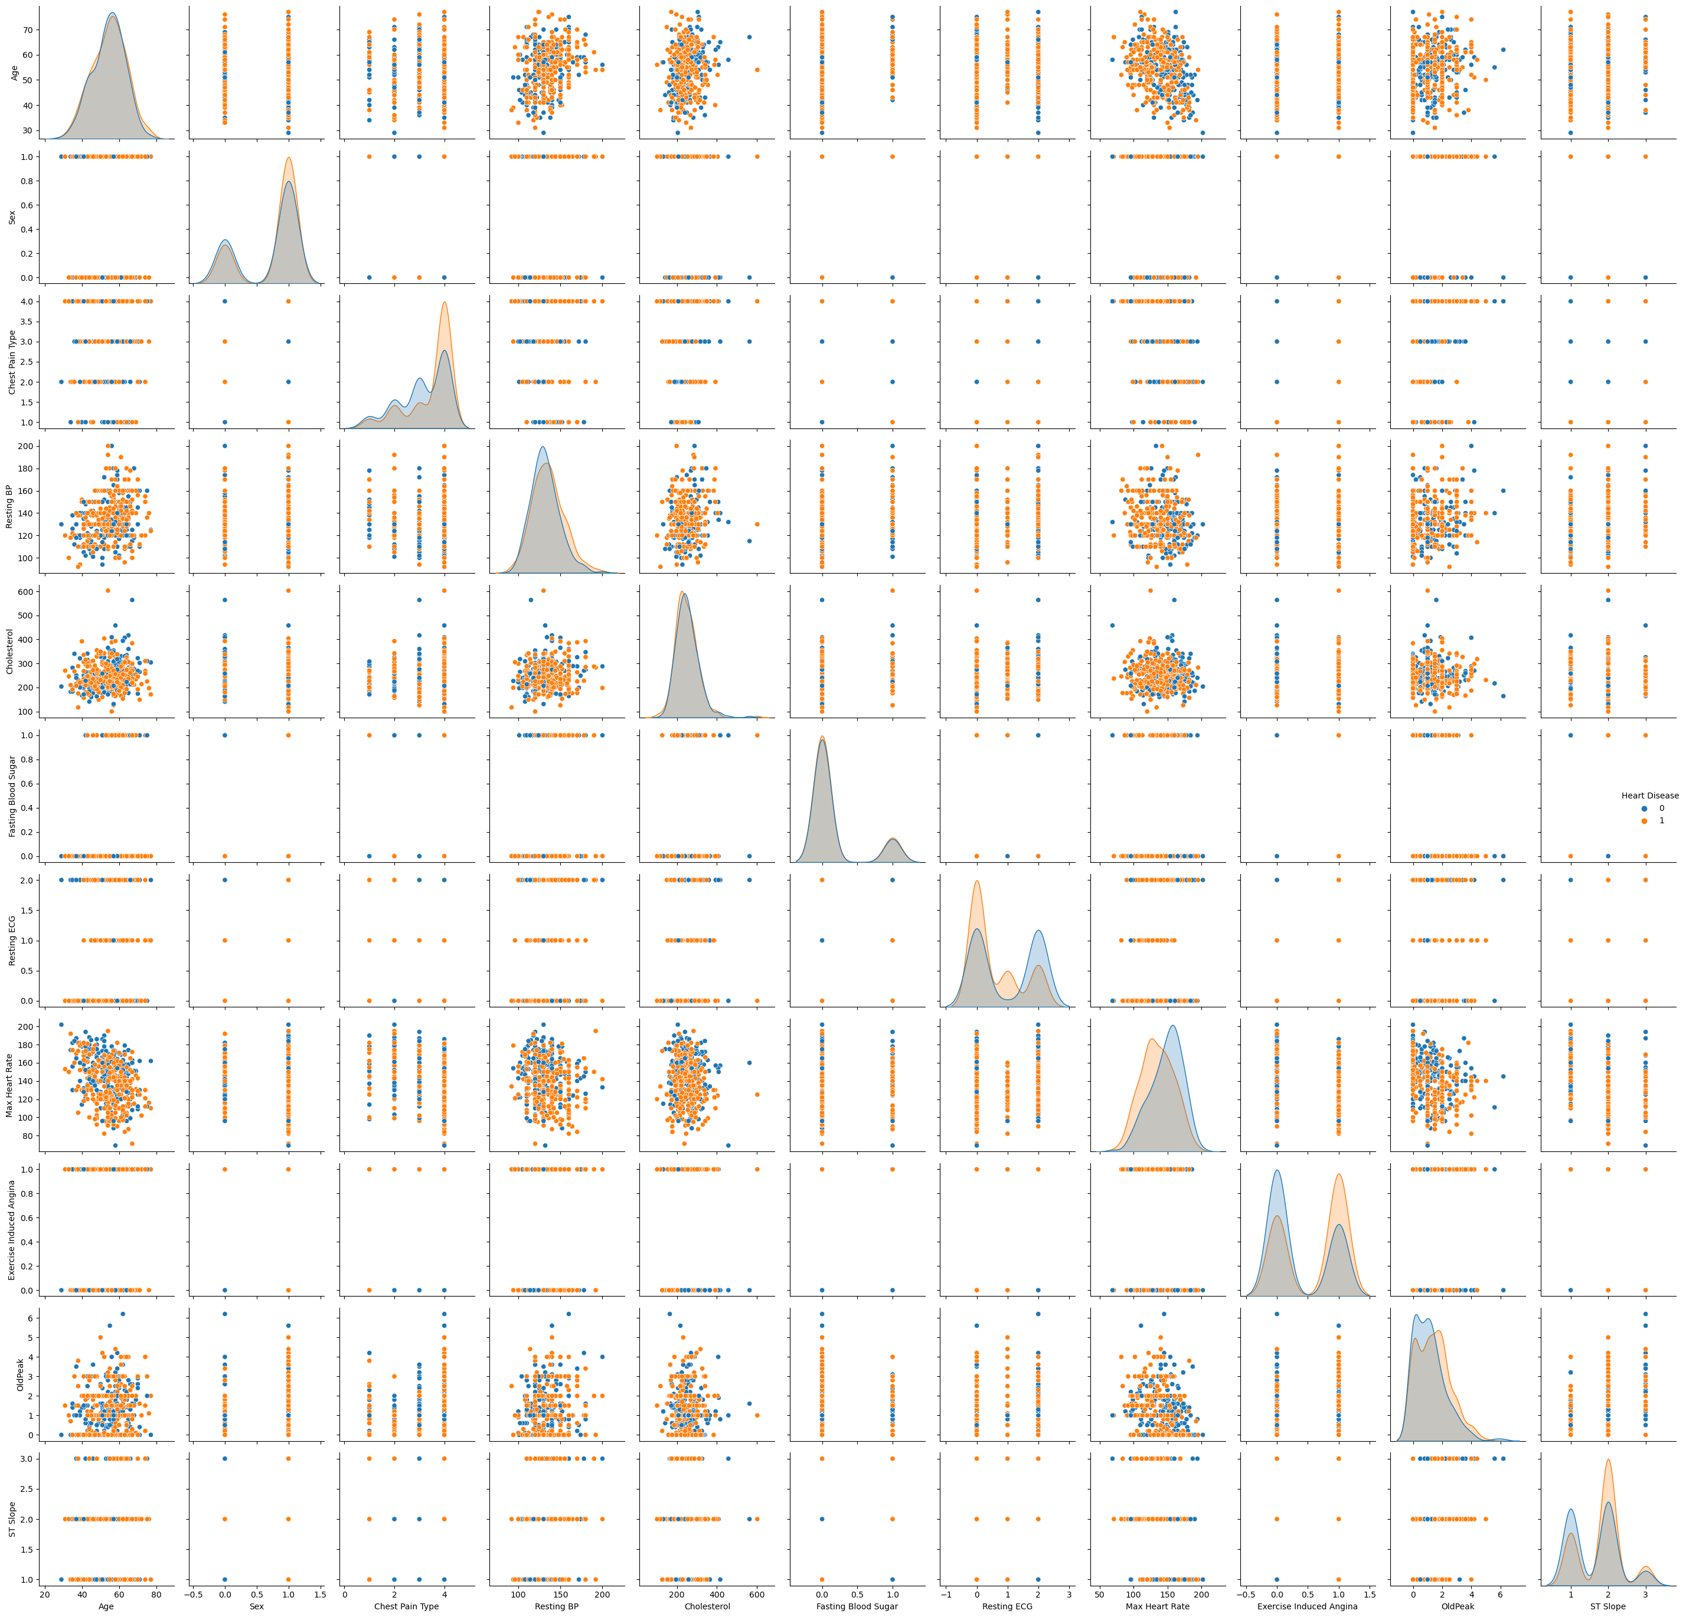
Scatterplot Matrix

Slide 11
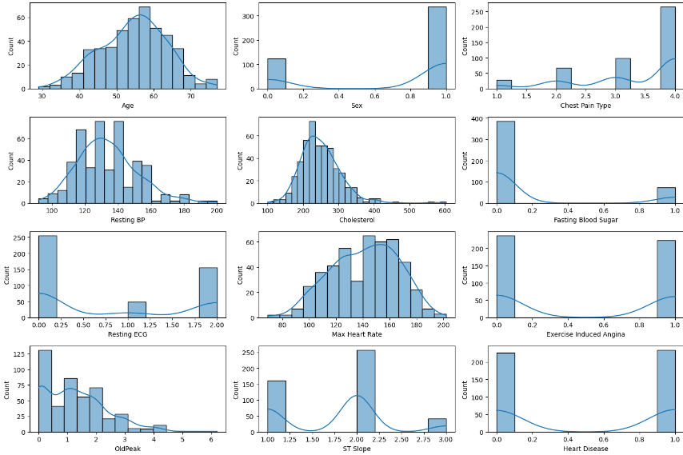
Distribution by KDE

Slide 12
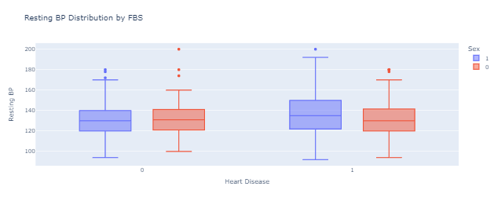
Box Plot Distribution

Slide 13
Logistic Regression Model Data Preparation
Connecting to PostgreSQL database
Moved continuous variables into new table
+ categorical columns
encoding as dummies to complete data
Converting Boolean variables to Binary

Slide 14
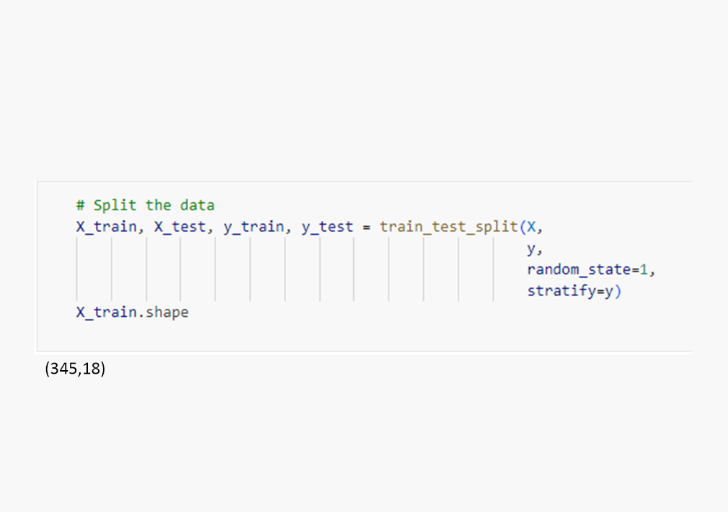
Training & Testing Data
Split Data
Performance on unseen data
Y Represents the target variable (num)
X Contains Remaining Features
75% of data is used for training
25% of remaining data is used for testing

Slide 15



Creating Logistic Regression Model
Specifying Parameters
Solver set for optimization
Maximum Iterations
Setting random state for reproducibility
Fit Model Using Training Data
Learning from Patterns
Understanding how Features relate to target Variable
Make Predictions Using Testing Data
Model used to predict testing data
Target Variable predicted based on what model learned
Shows how well model preforms on unseen data

Slide 16

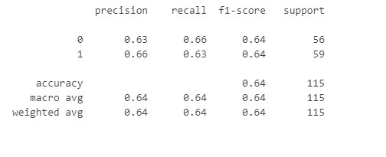
Evaluate the model's performance
Confusion Matrix
Classification Report
Shows
True Positives 37
True Negative 19
False Positives 22
False Negatives 37
Model Performance Summary

Slide 17
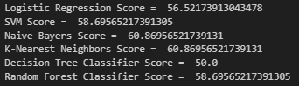
Classifier Models
Data Preparation
Train- Test Split
Define Models
Model Training
Model Evaluation

Slide 18
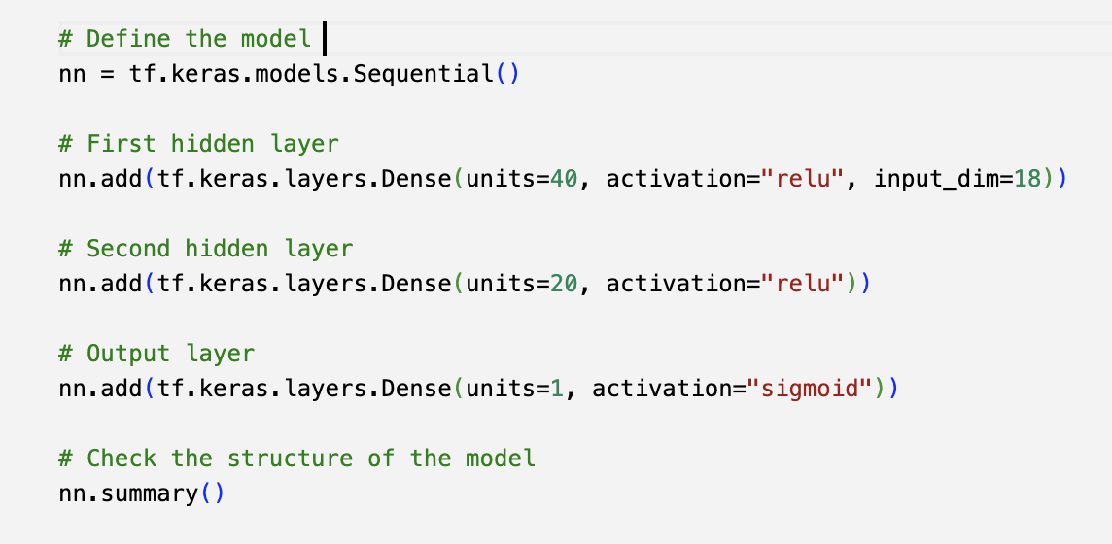
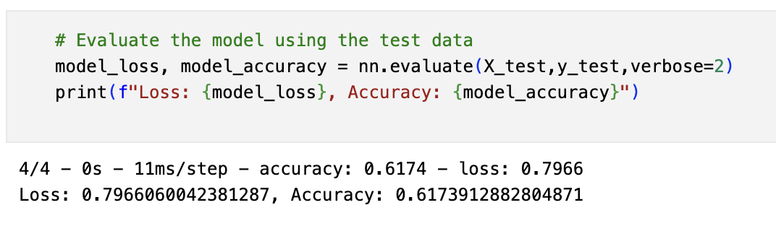
Neural Network Models
Different Assumptions
Solver set for optimization
Maximum Iterations
Setting random state for reproducibility
Fit Model Using Training Data
Different assumptions
Experiment with parameters
Tedious process with no accuracy improvement over logistic regression thus far
Learning from Patterns
Understanding how Features relate to target
…
Model used to predict testing data
Target Variable predicted based on what model learned
Shows how well model preforms on unseen data
Notes:
1. Given the results from our binary classification models, we moved on to neural network models
ASSUMPTIONS:
Although the logistic regression model assumes linearity, the neural network model does not and is capable of handling more complex relationships.

Slide 19
Using KerasTuner
Method that creates a new Sequential model with Hyperparameter options
1
Let Kerastuner decide which activation function to use in hidden layers
2
Kesrastuner to decide number of neurons in first layers
3
Allow Kerastuner to decide number of hidden layers & Neurons in hidden layers
4
Compile the Model
5

Slide 20
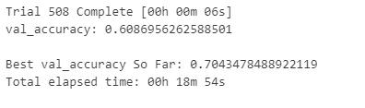
Search for best Hyperparameters

Slide 21
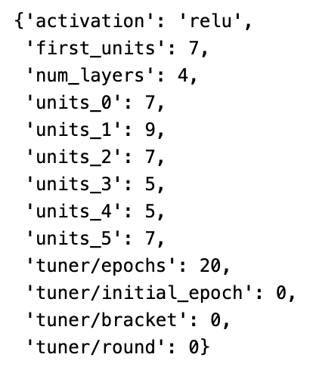
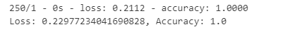
Evaluate Best Model Against Test Data
Tuner retrieves the best model from the tuner
Evaluates its performance on the scaled testing data
Prints out the loss accuracy metrics
Notes:
When we retrieved the best hyperparameters from the data
So our model had the same activation function that we had first attempted to utilize.
But would have several more input layers than any of the neural network models we
Attempted manually
And way fewer neurons in each layer than any model we tried manually
But the most noticeable difference is the accuracy score of 1.

Slide 22
Conclusion
Given patient data, we explored different machine learning models to predict heart disease.
Neural network model produced the best accuracy, but not without concerns.
Notes:
We scaled the data, which we exported as a csv to use for all our models
Binary Classifiers: Logistic regression, decision trees
The Keras Tuner provided parameters which resulted in an accuracy score of 1
Overfitting / memorization
Biggest weakness in all the models is having a small dataset which isn’t diverse enough
Future work for a project of this type would involve ensuring the dataset is large enough to produce a meaningful results
And the potential for experimenting with models given different columns, rather than all columns in the entire dataset

